Slide 1
HAPPY INSURENS Revenue analysis
ADAM MARGALIT
AMI sharaabi
Gal etzion

Slide 2


Slide 3
Here to Bring happiness in the least happy moments of your life
“
”
Richard Branson

Slide 4

Basic Assumptions Of The Project
Basic assumptions of the project
-In Depth Analysis of Revenue from a Geographical Standpoint
-Provide an Overview of Key Distributers
-Biggest Market- USA, a Closer Look
- 3 Guiding Insurances: Health, Life, Property

Slide 5
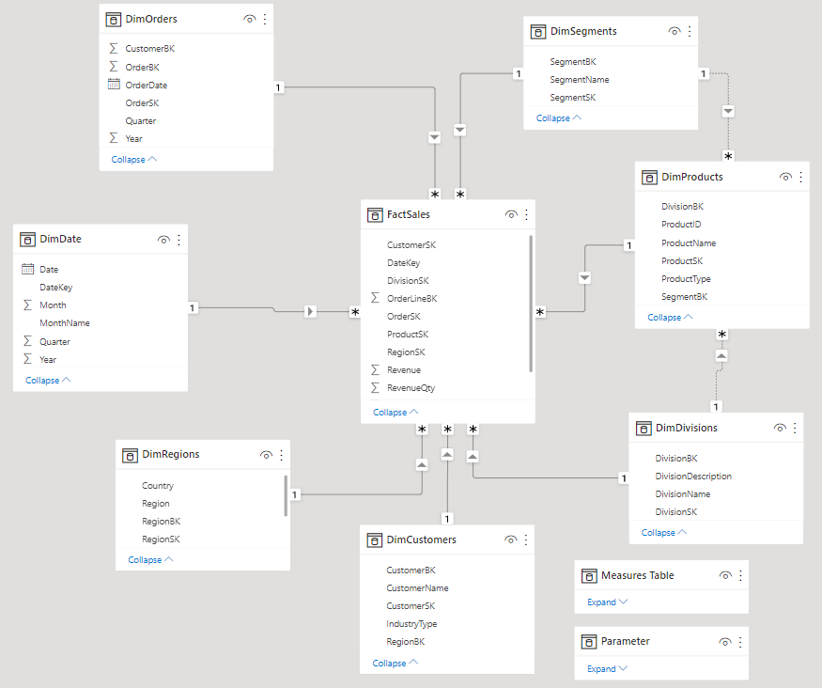
Star scheme

Slide 6
workflow
1st Step | SQL- Happy Insurance DB and Dim Date Creation
2nd Step | Transfer to Power Query, Cleansing Data, Dimensions and Fact, Snowflake.
3rd Step | PowerPivot Created Measures and formed the relationship model for swift analysis.
4th Step | Load to PowerBI. Dashboards, Visualizations to analyze data visually
5th step | Used DAX to create complicated measures and to further analyze based on our initial impressions.

Slide 7




Challenges
From Raw Data to Report
Most costly challenge was the technical knowledge and procedures required to manipulate data across the different UI’s
Initial date table was faulty, forced us to redo the whole ETL process from the beginning
Coding fluency in M-Language, SQL, DAX took time to develop.
Down stream effects of human error on visual presentation of data (i.e Bookmark desynchrony showing wrong region when buttons pressed
Dealt With BY
Reviewing related issues in discussion forums on the internet
Going over video material from class
Many hours of good old “Breaking the Head”

Slide 8
Trends by Segments
-Third Degree Relative Insurance Products Consistently Trending at #1
-Property Insurance Products Consistently Perform Poorest.

Slide 9
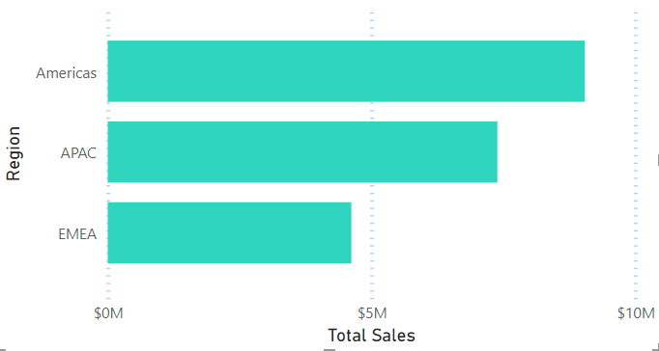
Sales by region
-Americas Account for Almost Half of the Total Sales
-Although Europe (EMEA) has most diverse clientele, Accounts for less that ¼ of Revenue.

Slide 10
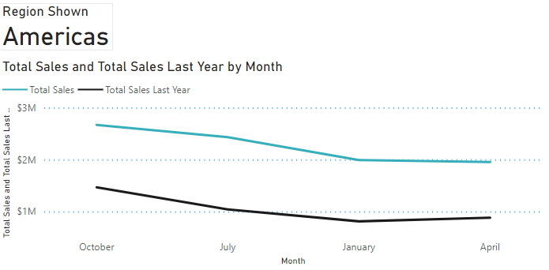
Sales by region
-Large Positive Margin When Comparing Previous Year in the Americas
-Last Quarter (October) Garners Largest Sales Number Year Over Year

Slide 11
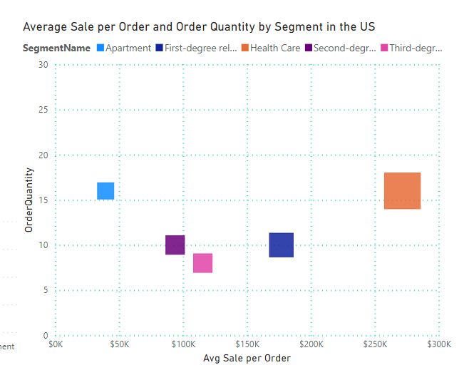
Sales by region
- Health Care is the Leading Product (Division) in terms of Sales.
-In the USA, Health Care Insurance Sales Outperform Property Sales Over 6-Fold.

Slide 12
Happiness to all

